Slide 1
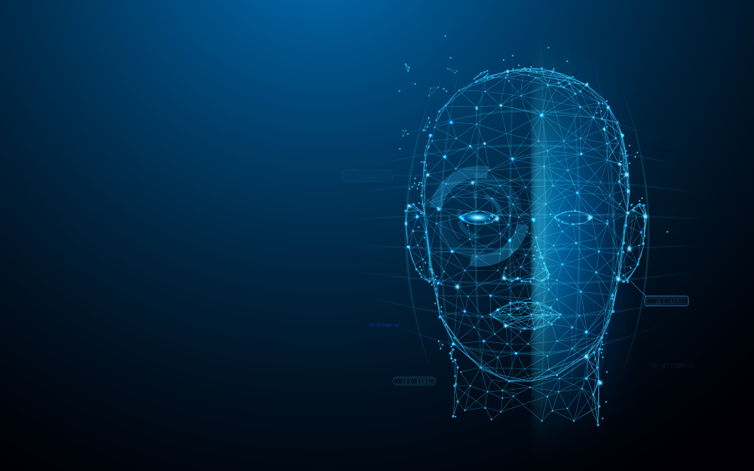
Human Face Recognition Attendance System
Group Member:
Giriraj Parihar - 19MCA1069
Pushpita Ganguly – 19MCA1069

Slide 2
IntroDuction
As we are making a system which can recognize face and match with its own database. It will make the attendance system more authentic. Our primary goal is to help the lecturers, improve and organize the process of track and manage student attendance and absenteeism.

Slide 3
What Is Face Detection?
Face detection is a type of computer vision technology that is able to identify people’s faces within digital images. This is very easy for humans, but computers need precise instructions. The images might contain many objects that aren’t human faces, like buildings, cars, animals, and so on.

Slide 4
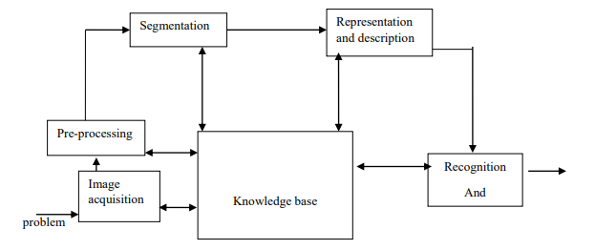
Plan of works

Slide 5
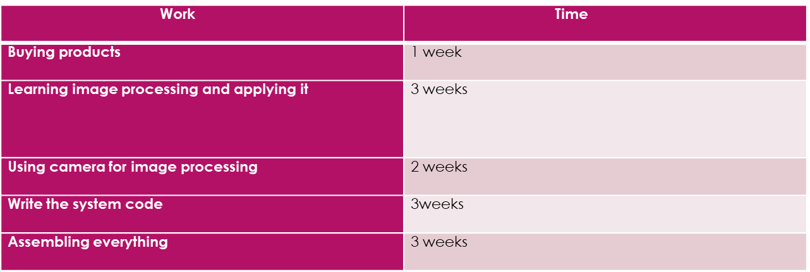
Time Frame

Slide 6
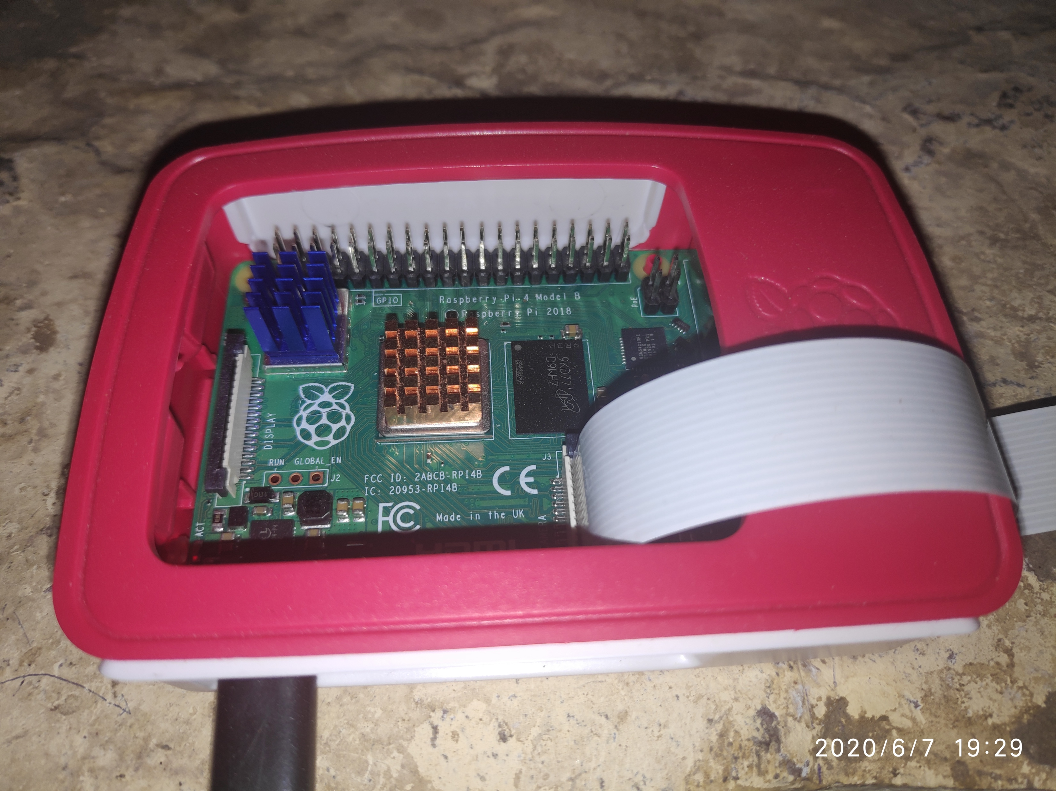
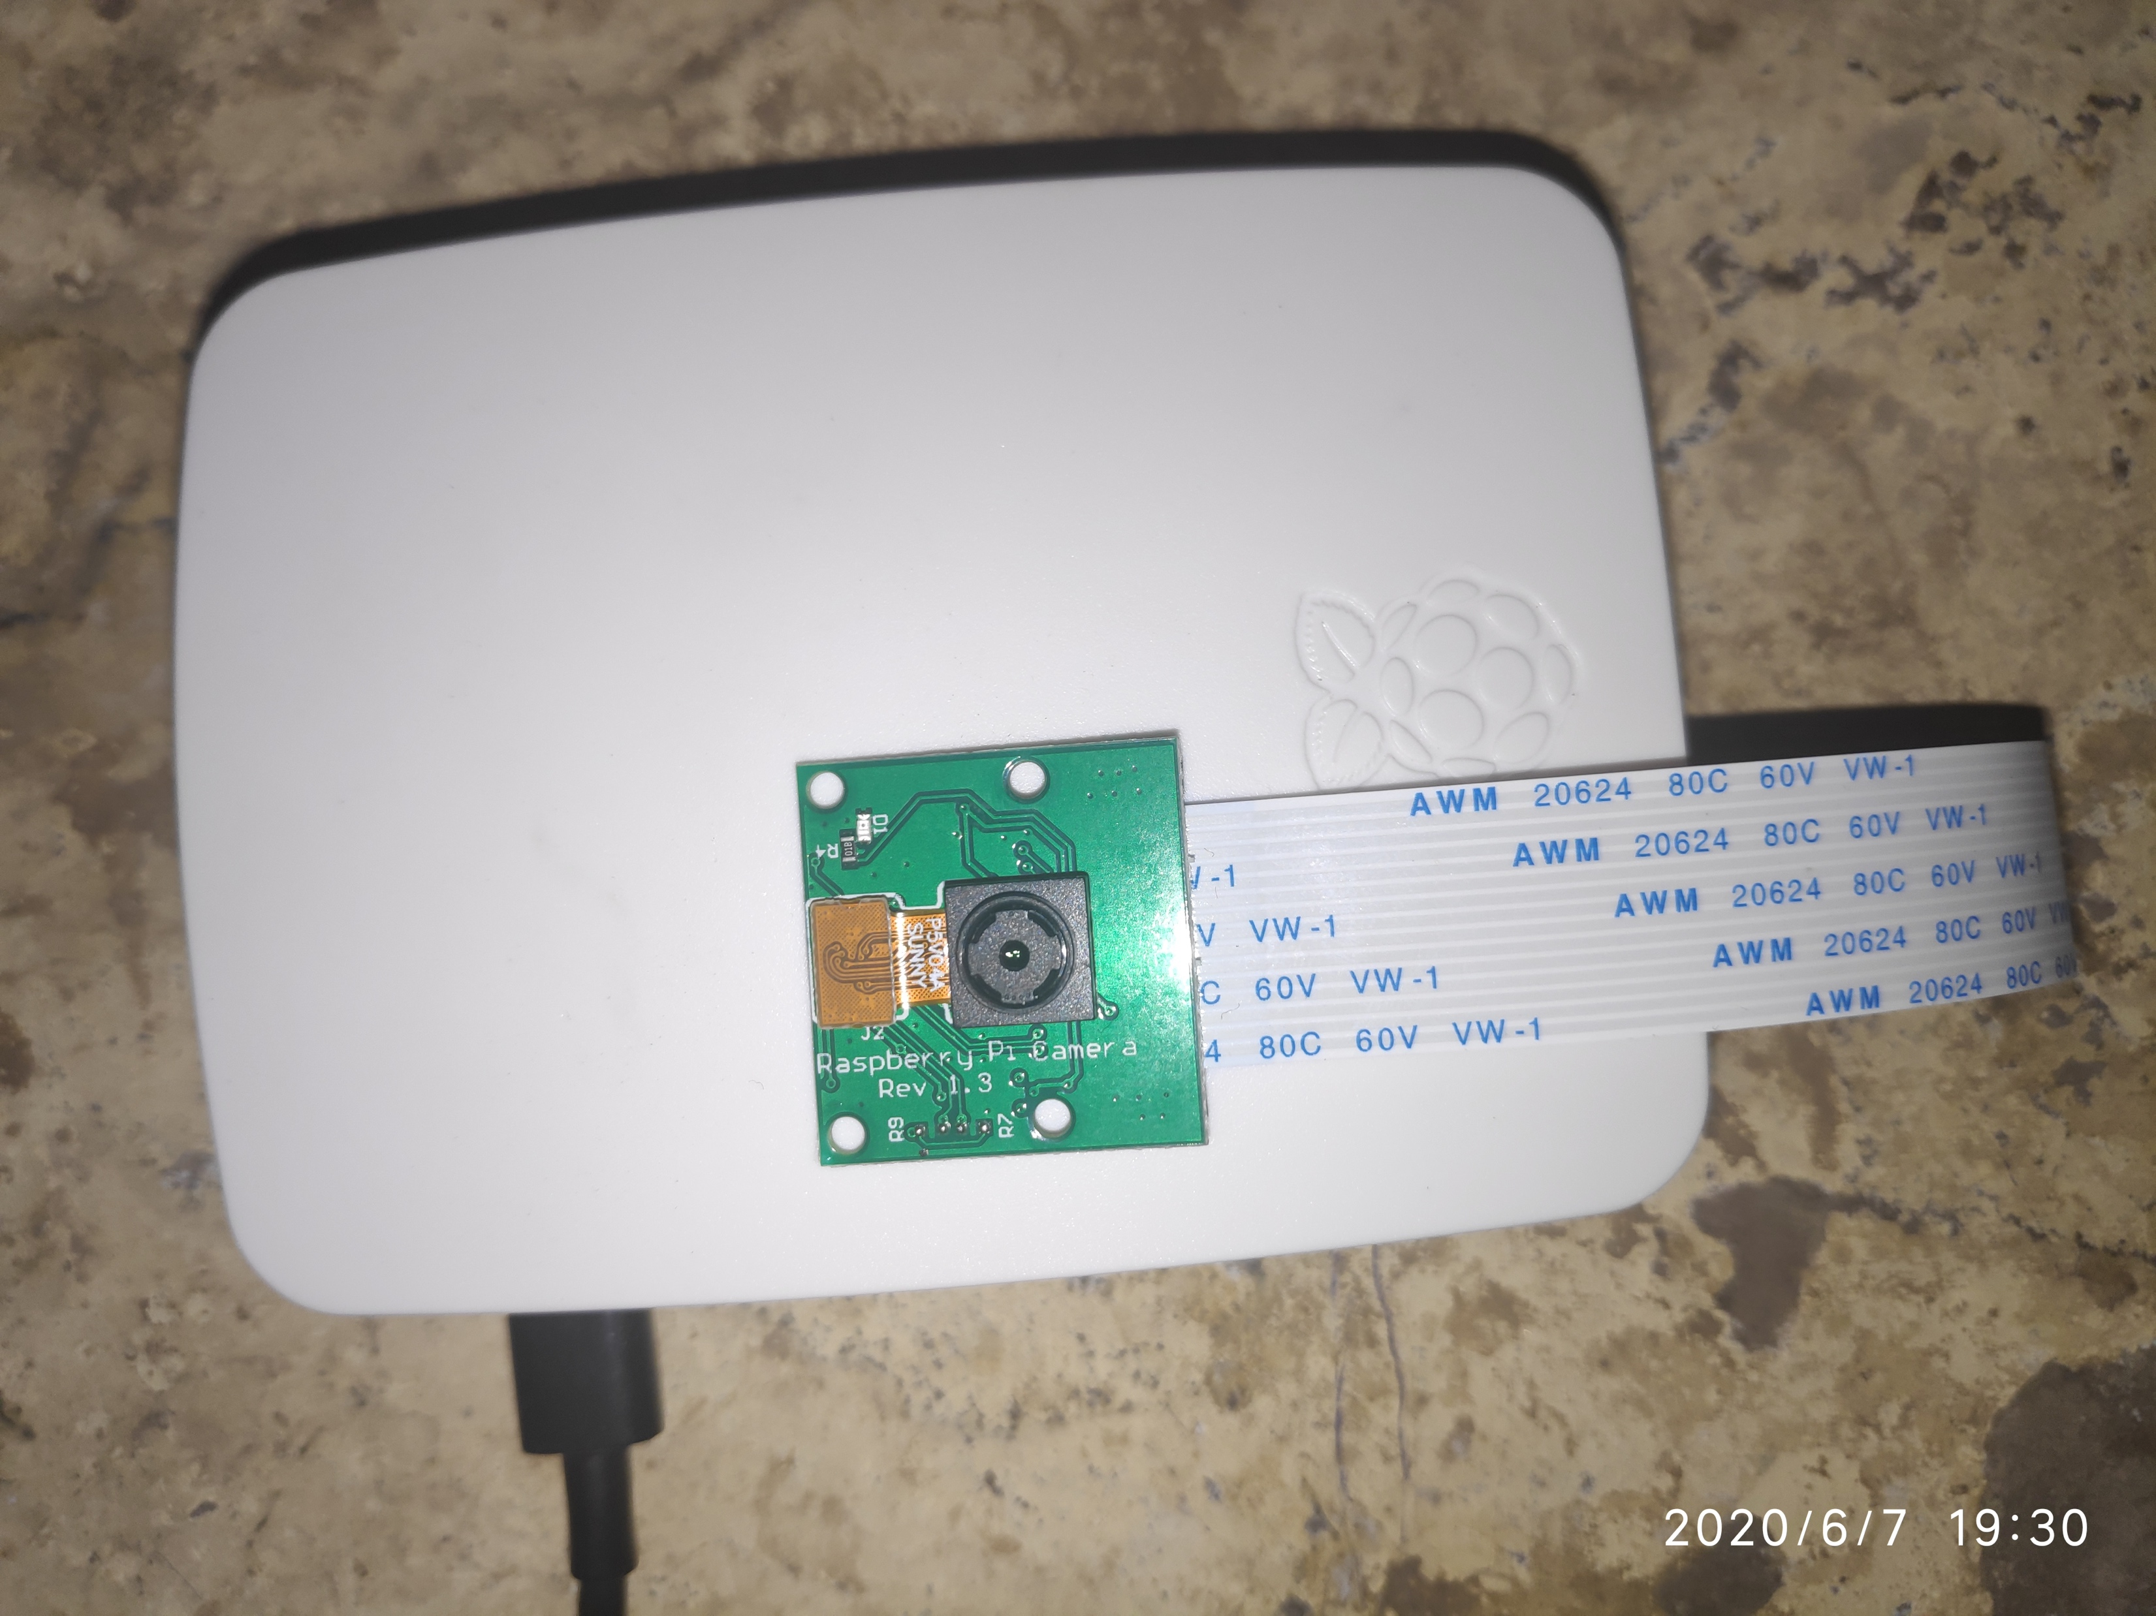
Hardware
Raspberry Pi 4
5MP Camera Module

Slide 7
Software Used
Program language: Python 3.7

Slide 8
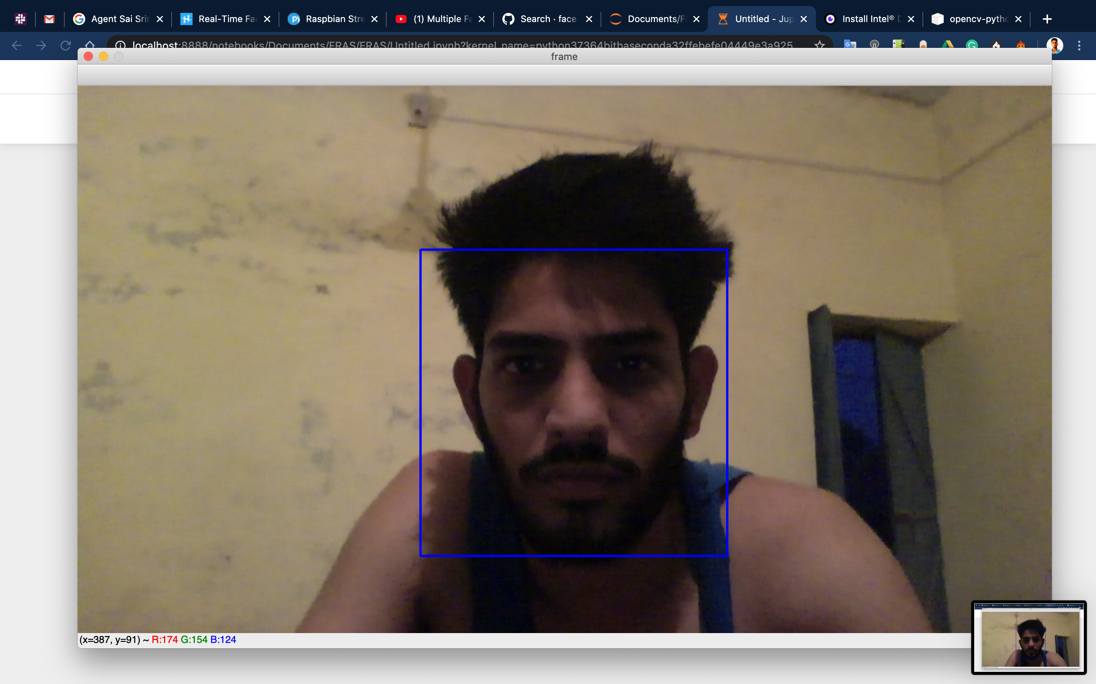
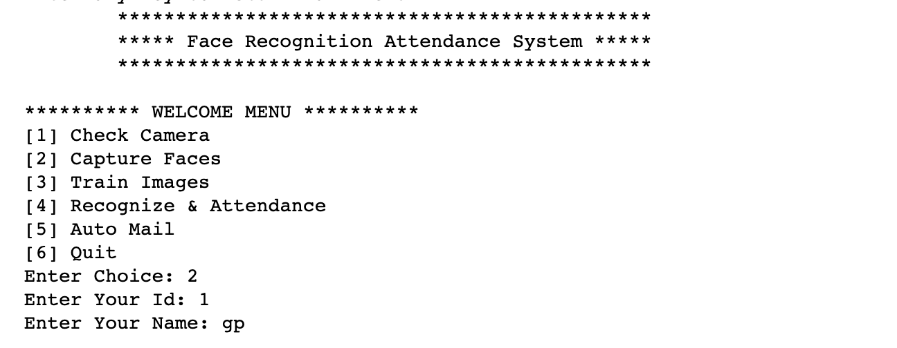
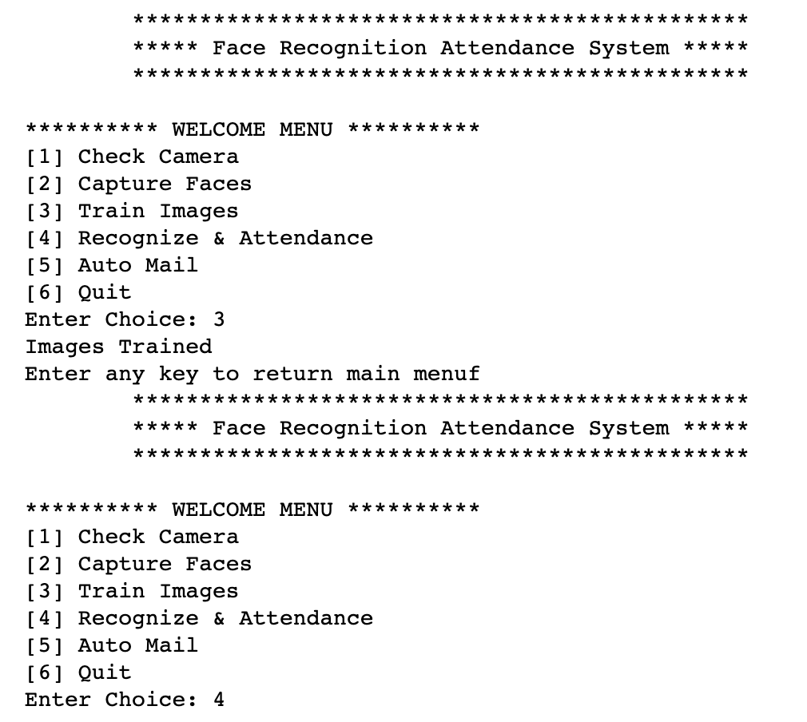
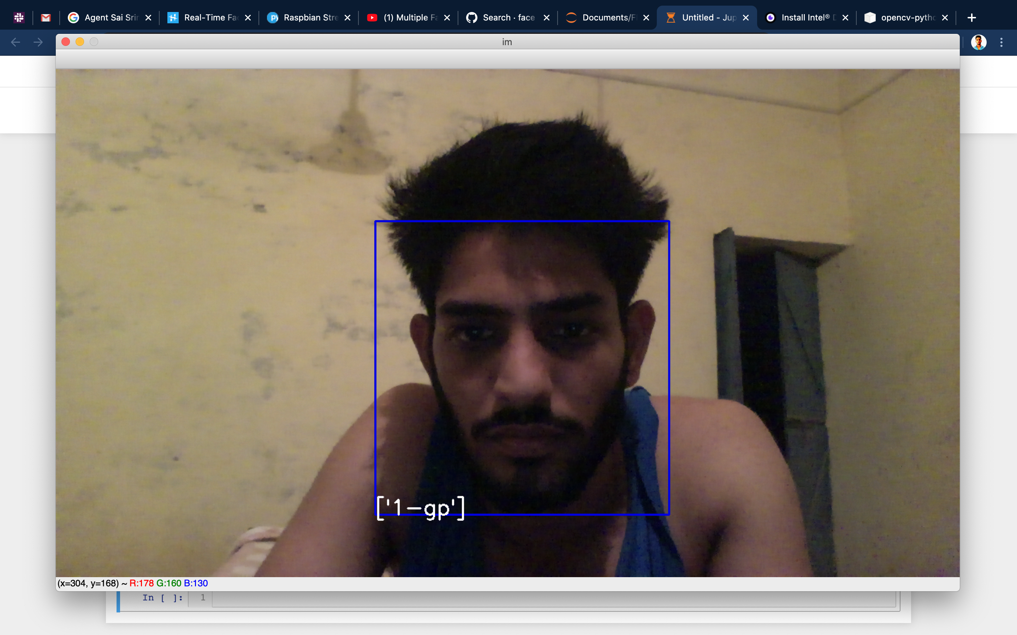
FRAS Interface

Slide 9
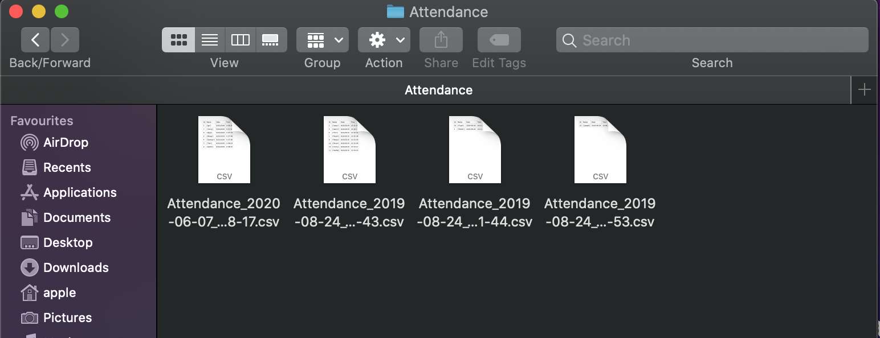
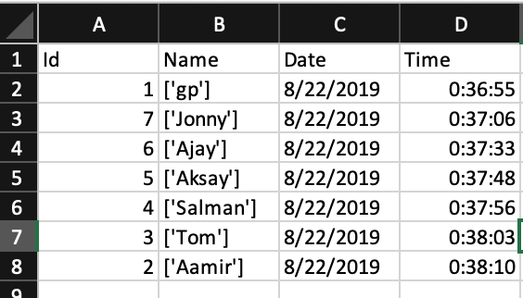
FRAS Interface (continue..)

Slide 10
Advantages
The system stores the faces that are detected and automatically marks attendance.
Ease of use is manipulate and recognize the faces in real time using. Multiple face detection. Multipurpose software Can be used in different places.

Slide 11
Disadvantages
The accuracy of the system is not 100%. It can only detect face from a limited distance.

Slide 12
Result Analysis
In our project we have been working more the 1200 pictures. Result of our project percentages is almost 80-81%. Thou it is not enough for this little dataset. To make almost 98% accuracy we need to use more powerful hardware and also need more resources.

Slide 13
Why we don’t use Neural Network.
Raspberry Pi isn’t powerful enough to compute the images using neural or deep learning.
The problem are:
not enough ram
Processor is slow
not the right hardware for heavy computational processes

